Slide 1

CHANGE 0
Learning how to learn
and learn fast?
Presented by: Trần Đức Thắng

Slide 2

OVERVIEW
01
What is learning and learning fast?
02
Why do we need to learn fast?
03
HOW TO LEARN FAST?

Slide 3



1 - What is learning and learning fast?
What is learning?
What is learn fast
“The process of gaining knowledge."
- Absorb knowledge quickly and effectively
- Grasp and apply information in a shorter amount of time

Slide 4

2 – Why do we need to learn fast?
Problem solving
Saving time
Adaptability
Competitive advantage

Slide 5

3 - HOW TO LEARN FAST?
Set clear goals
Simplify information
Healthy
Memory Techniques
Using AI and tools
Apply the Knowledge
Prioritize Key Information

Slide 6



Set clear goals
KNOW WHAT THE MEANING OF YOUR LEARNING IS AND HAVE CLEAR, SPECIFIC GOALS.

Slide 7



Set clear goals

Slide 8


Healthy
Health can significantly impact the ability to learn quickly.
Several aspects of health, both physical and mental, play crucial roles in cognitive functions and the learning process.
>>> GOOD HEALTH GOOD LIFE

Slide 9



Using AI and Tools
AI and tools can significantly support and enhance the learning process, offering various benefits.

Slide 10




Prioritize Key Information
- Identify the most important concepts or information.
- Focus on understanding the core material before delving into details.

Slide 11

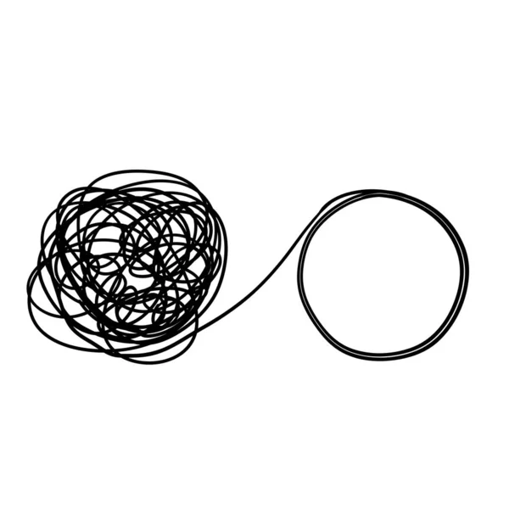
Simplify information
- After collecting the necessary information and understanding the main content, I will simplify the information by eliminating unnecessary content and rewriting them as simply as possible.
Besides, use clear language and arrange content that is easy to understand.

Slide 12
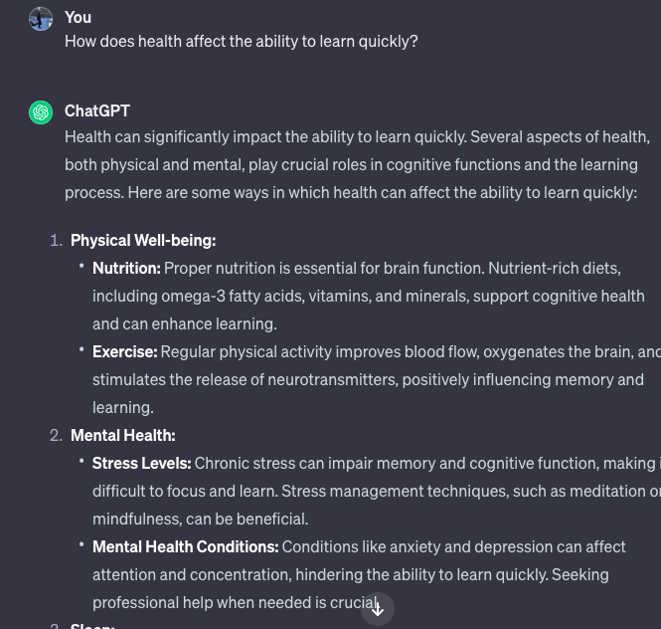
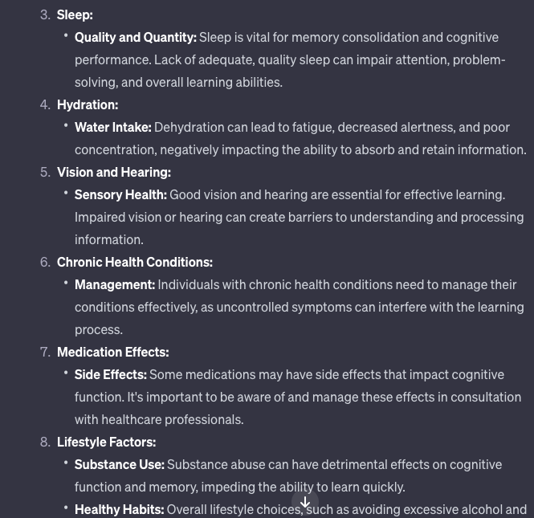
Simplify information

Slide 13

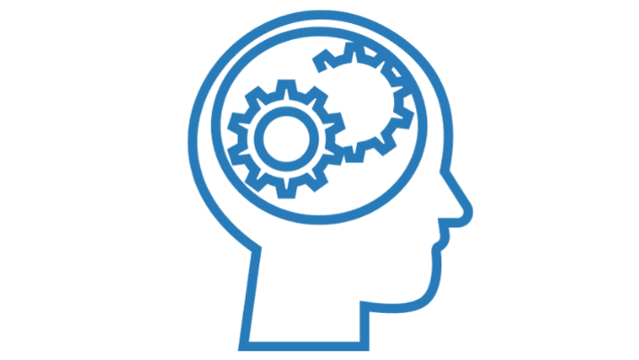
Memory Techniques
- There are many different memorization methods depending on the suitability of each individual to choose a memorization technique.
- For me, the most effective method would be the spaced repetition method.

Slide 14
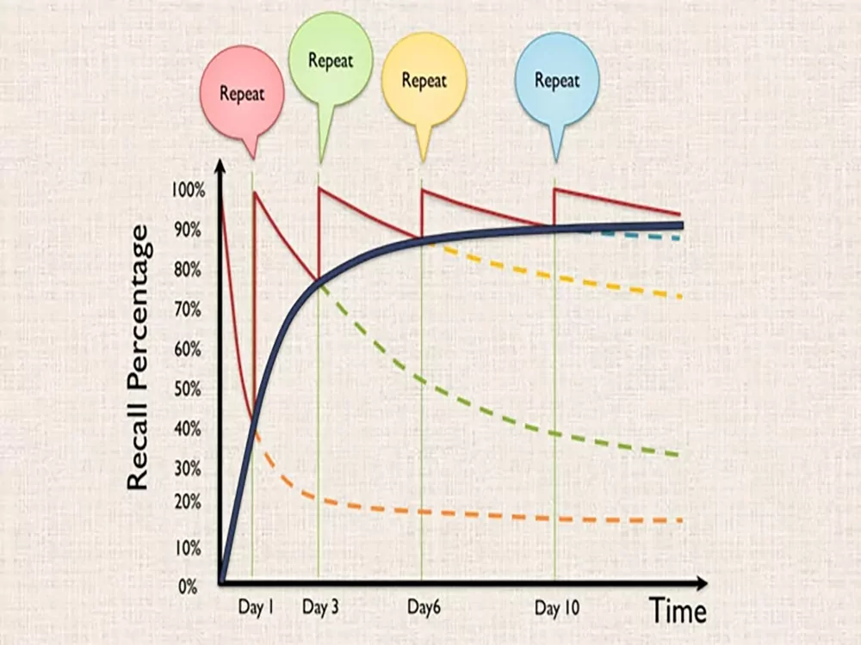

Slide 15


Apply the Knowledges
Find practical applications for what you're learning.
Apply the concepts in real-life scenarios to deepen your understanding.

Slide 16
Thank's For Watching

